Slide 1
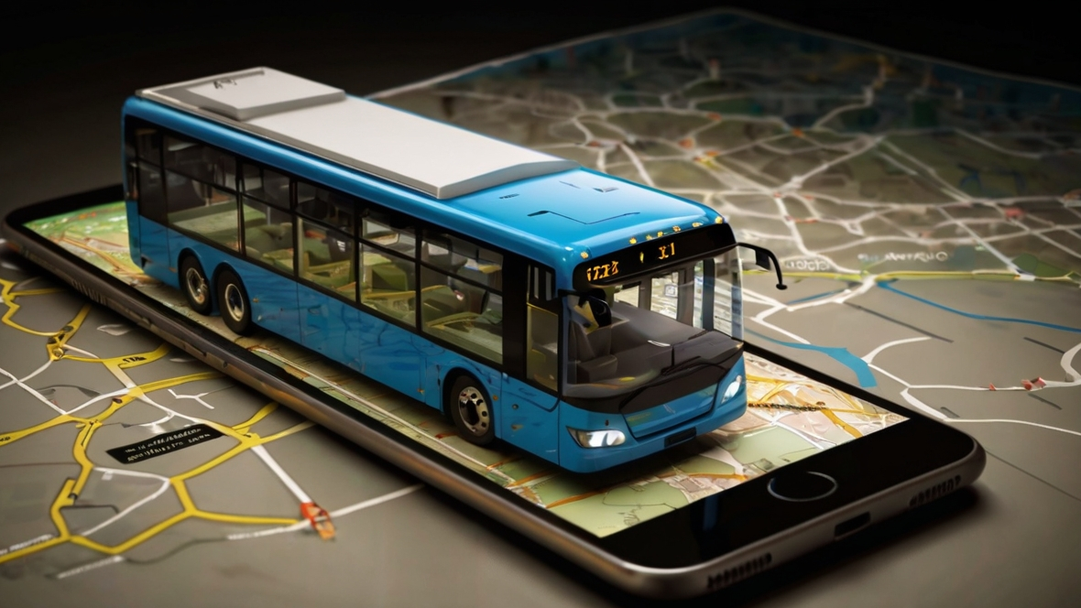

e-Conductor
Group 09
(Next Level of Sri Lankan Public Transport)
Department of Computer Engineering
Faculty of Engineering
University of Peradeniya
Sri Lanka

Slide 2
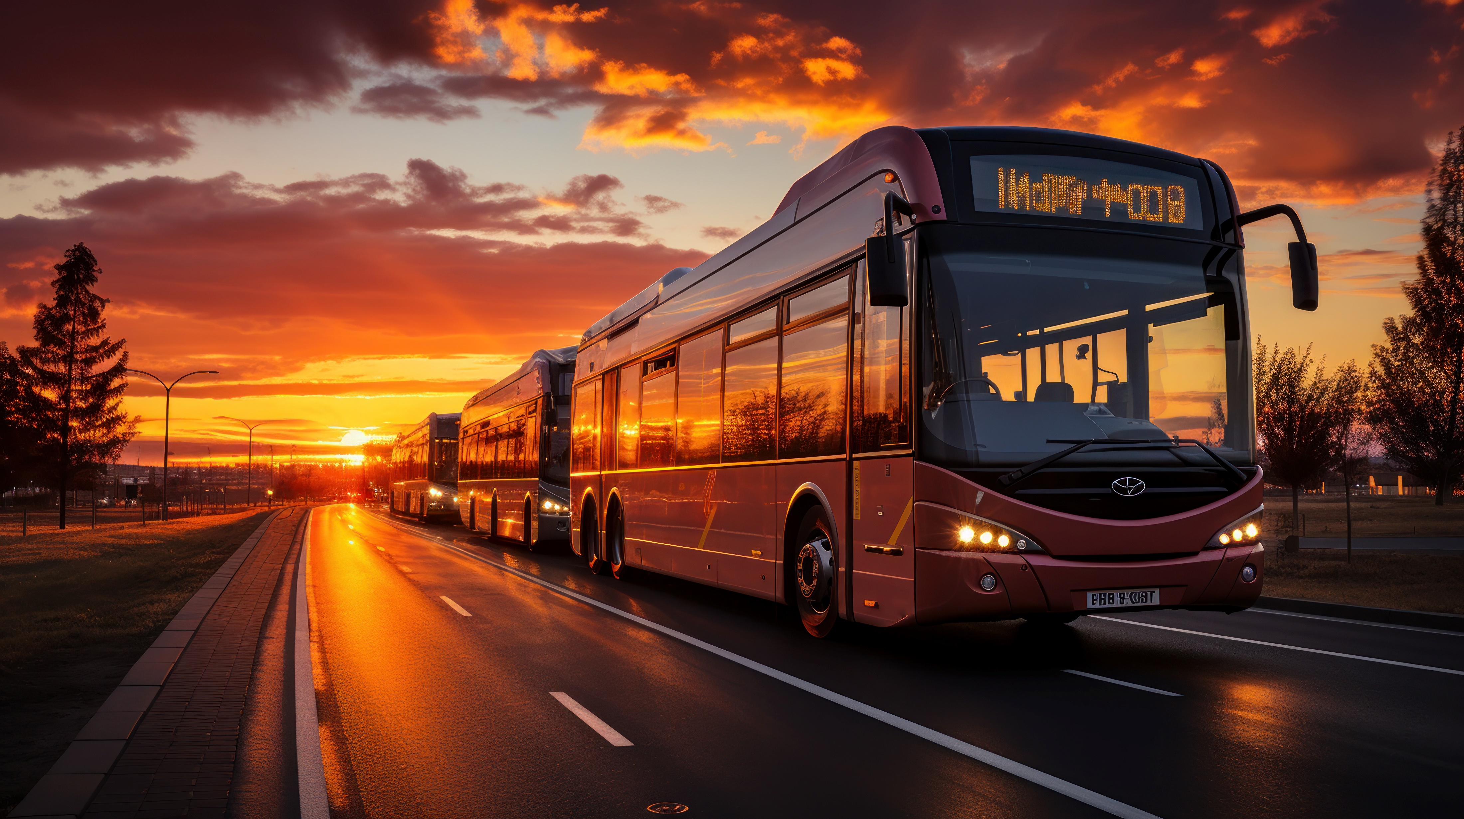
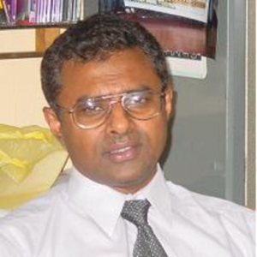
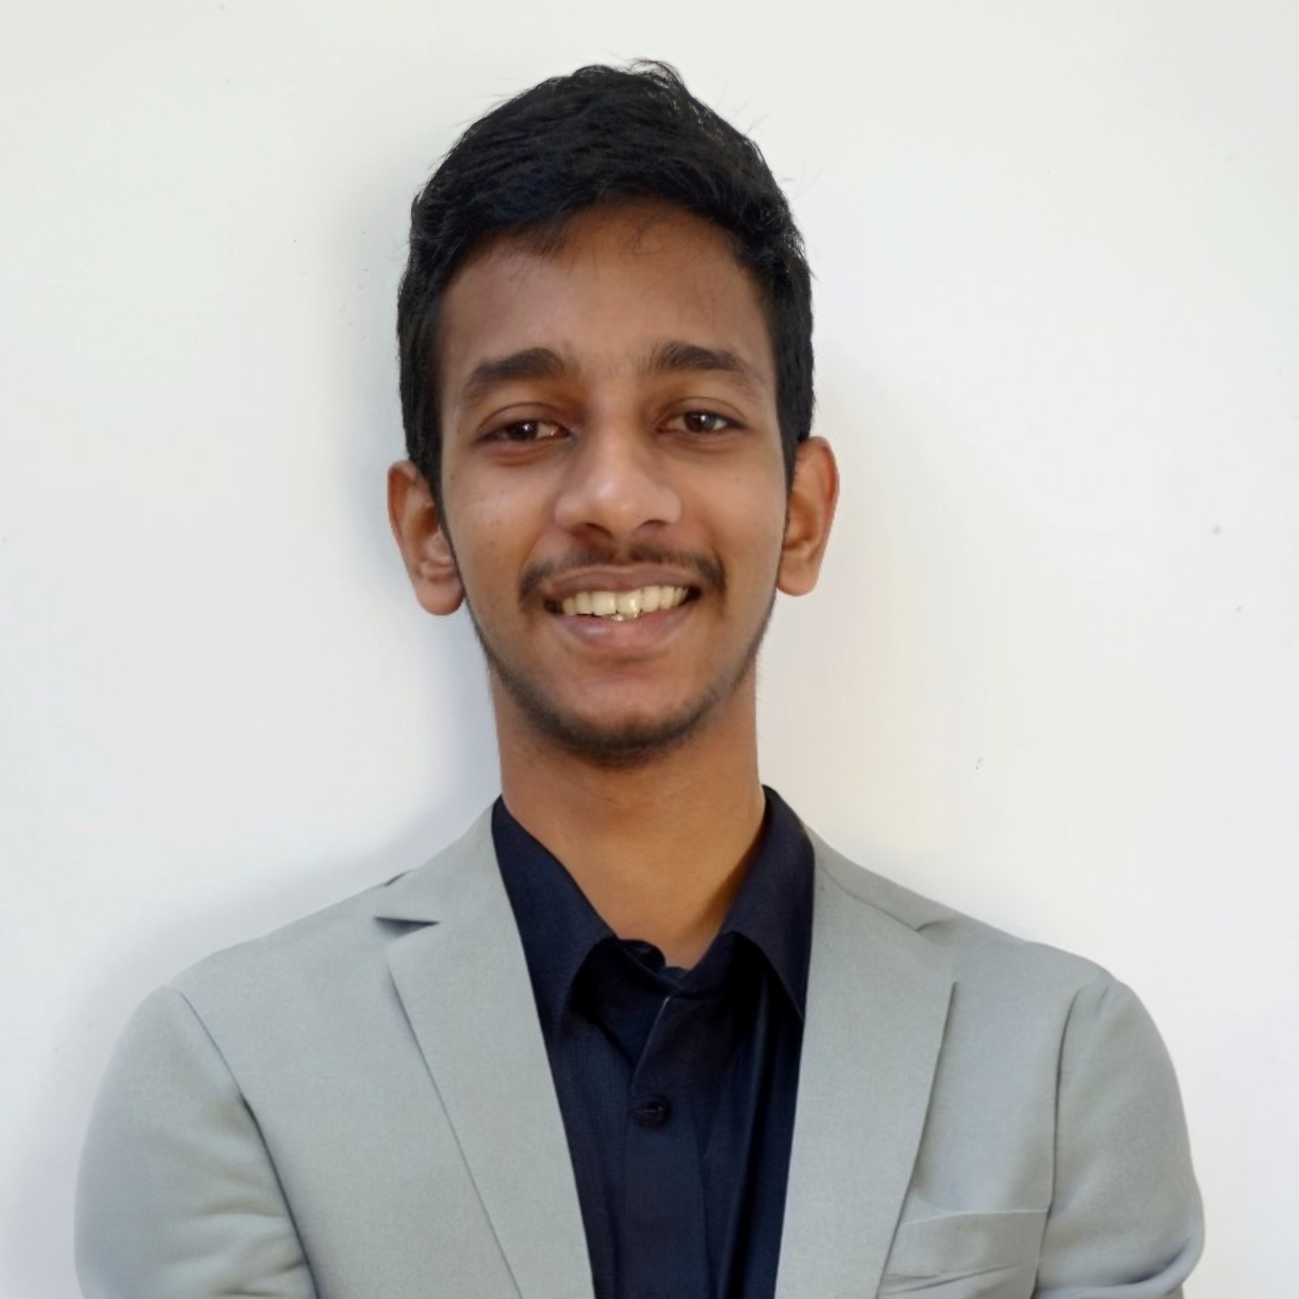
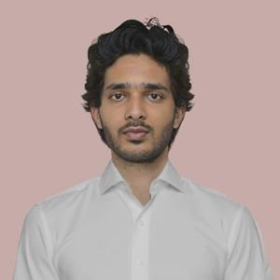
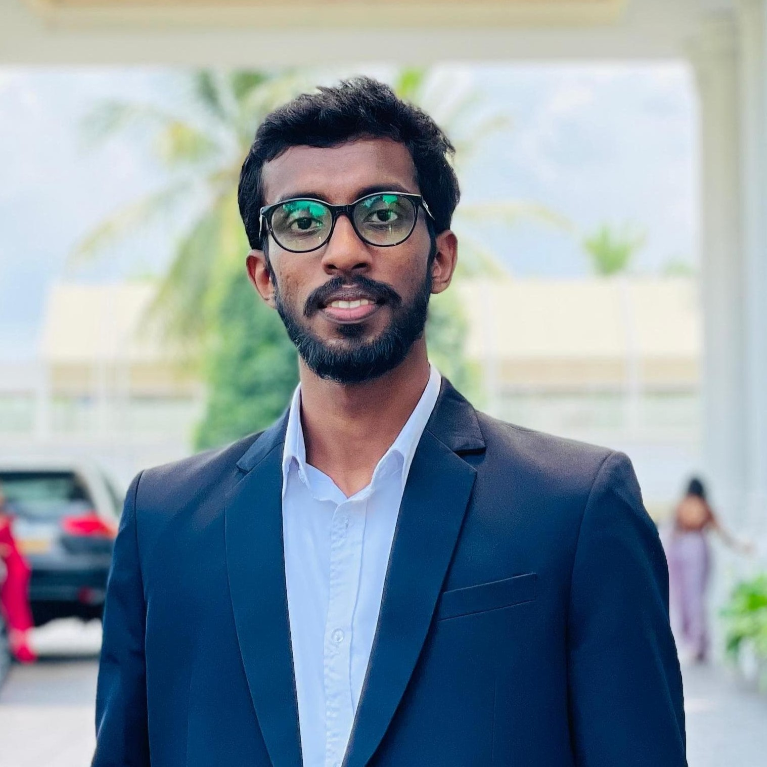
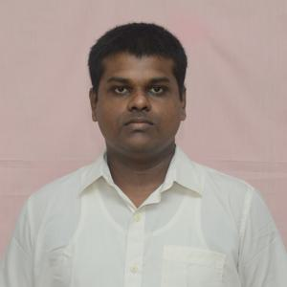
OUR TEAM
SUPERVISOR
Prof. Manjula Sandirigama
E/20/032
Bandara A.M.N.C.
E/20/035
Bandara K.C.H.N.A.W.M.R.C.J.N.
E/20/133 Haththella H.A.D.T.N.
E/20/157
Janakantha S.M.B.G.

Slide 3
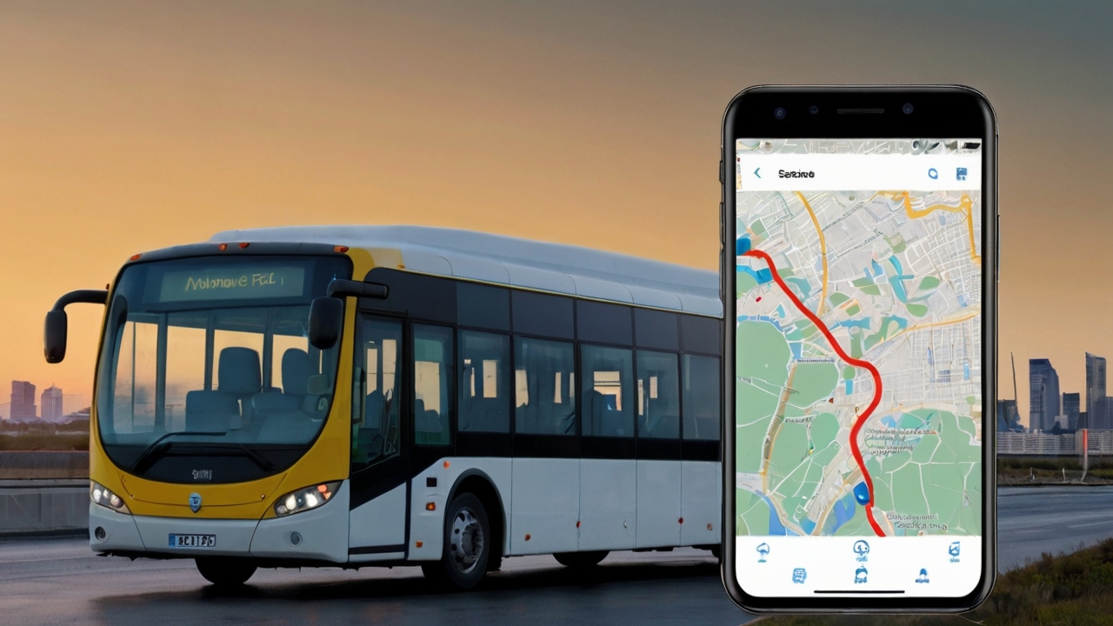
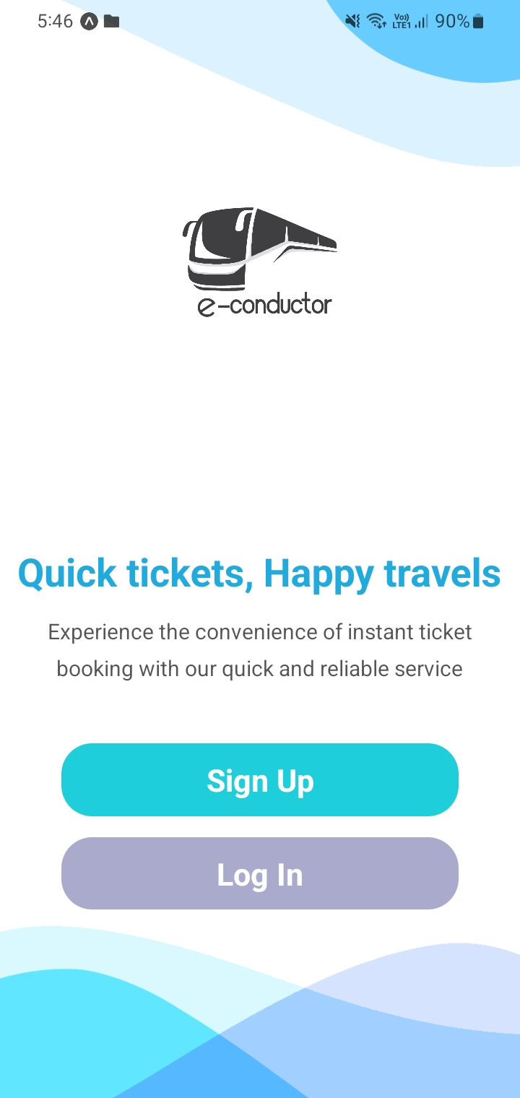





INTRODUCTION
Provide a convenient online platform
Streamline booking process, enhance user experience.
Search routes, select seats, live location tracking
Convenience, ease of use compared to traditional methods.
Improving accessibility to bus travel

Slide 4
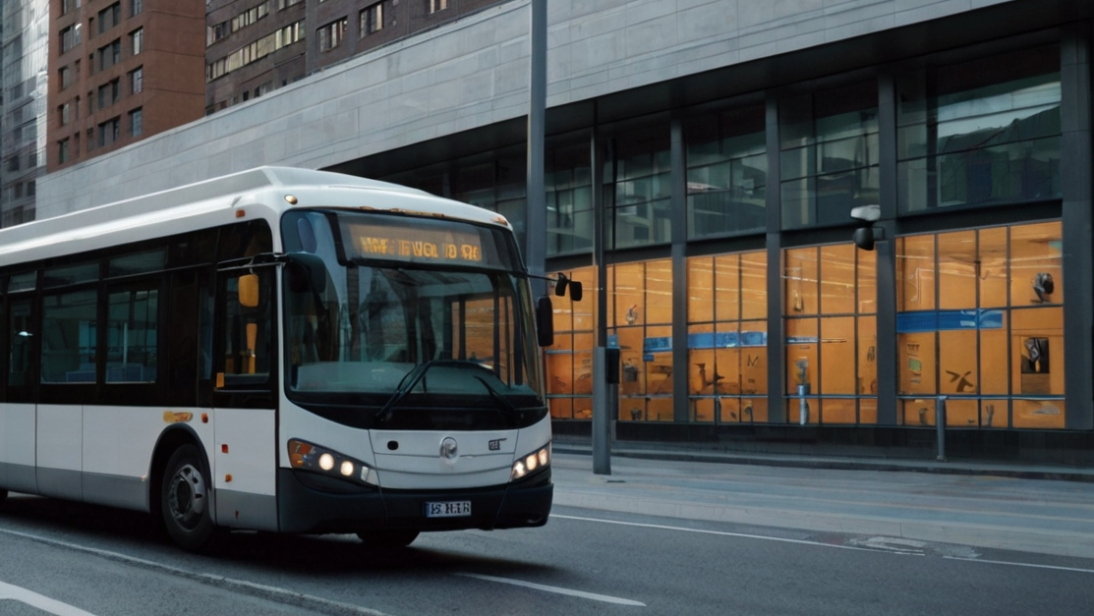




CORE FUNCTIONALITIES
Web App
Mobile App
Admin Site
Login / Signup
Ticket Booking
Ticket Cancelling
Reload Account
Realtime Bus Tracking
Earnings Analysis
Schedule Management
Login / Signup
Profile
Ticket Booking
Ticket Cancelling
Transactions
Realtime Bus Tracking
Analytics
Login / Signup
Transaction Tracking
User Tracking
Schedule Management
Bus & Bus Stop Tracking

Slide 5
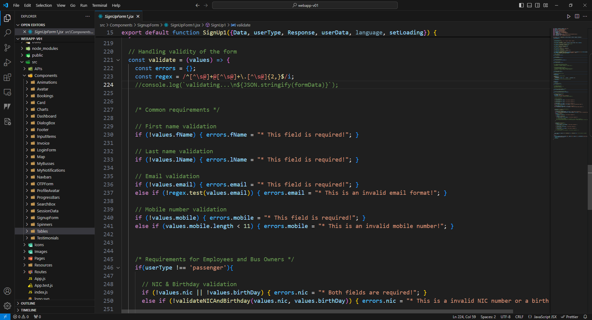
CODE & VALIDATIONS

Slide 6
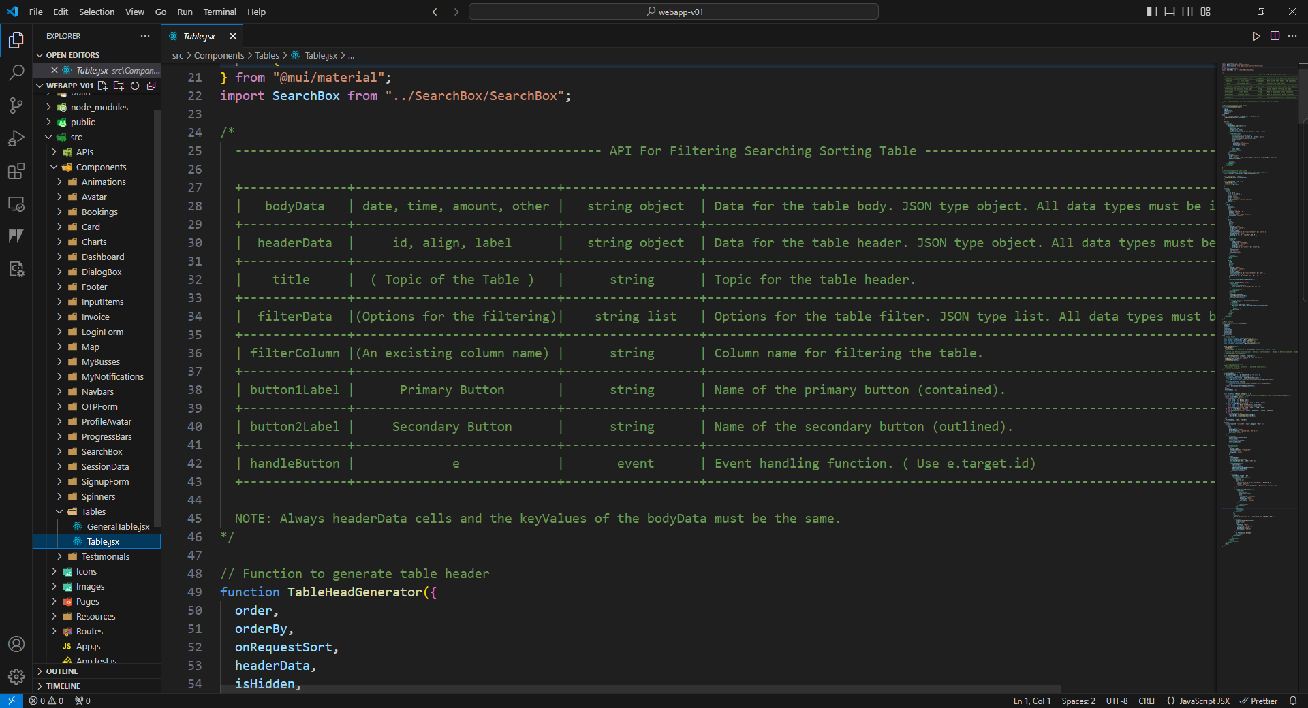
CODE & DOCUMENTAION

Slide 7
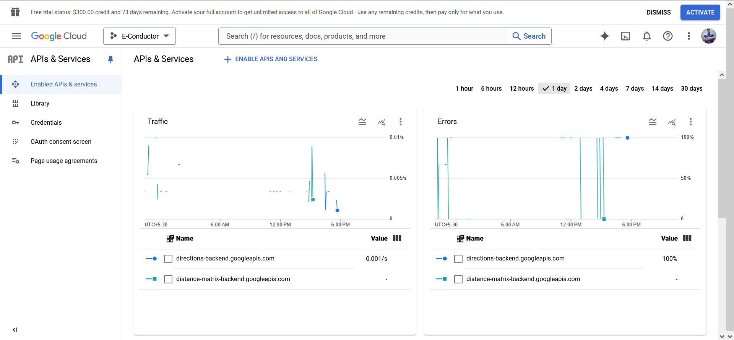

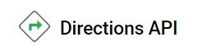
TESTING & BUG FIXING

Slide 8
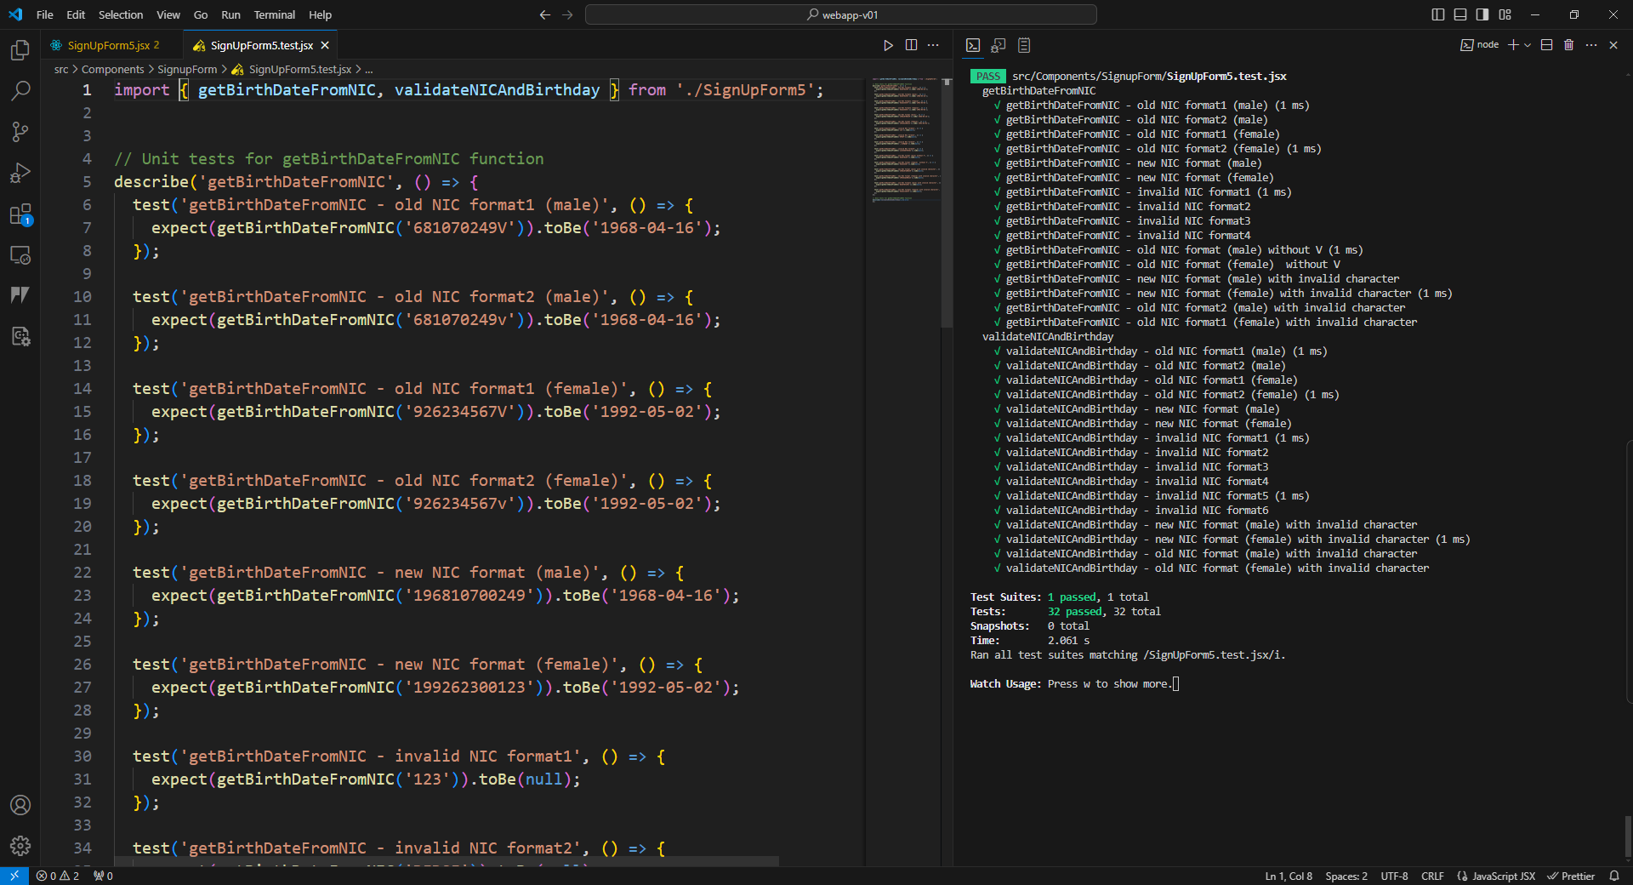



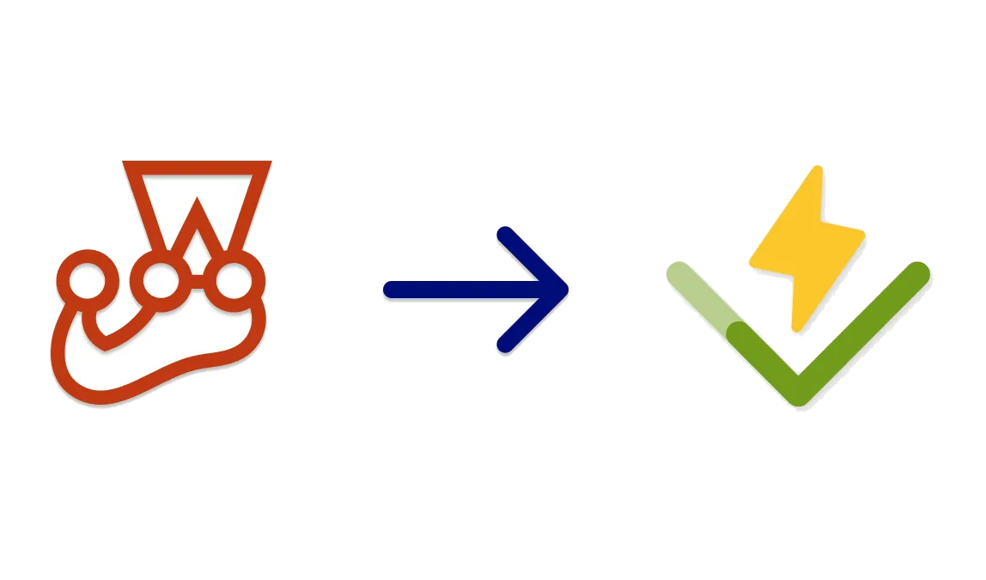

TESTING & BUG FIXING

Slide 9
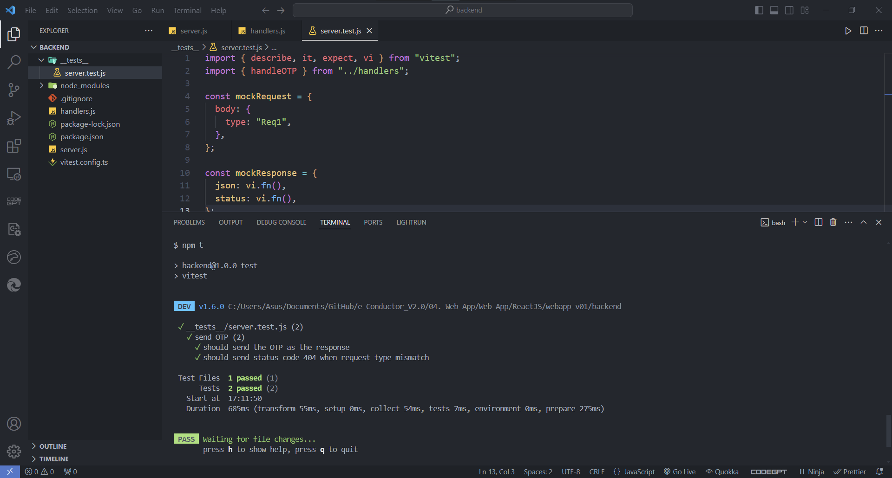
TESTING & BUG FIXING

Slide 10
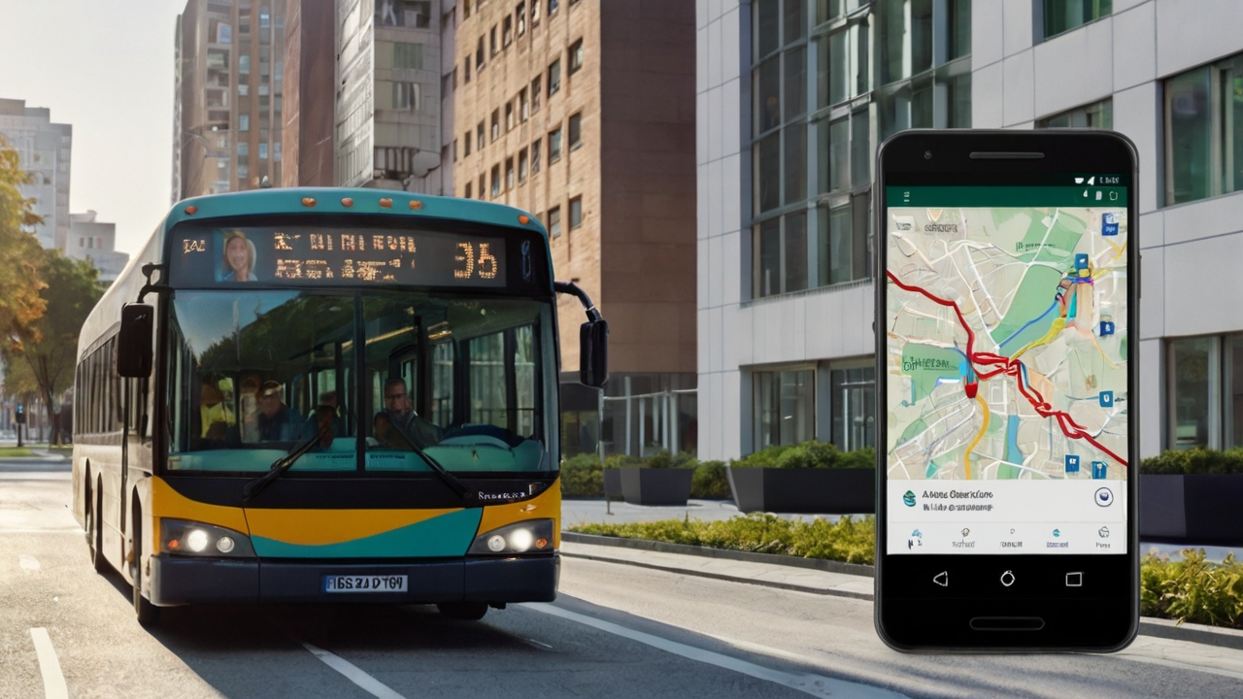






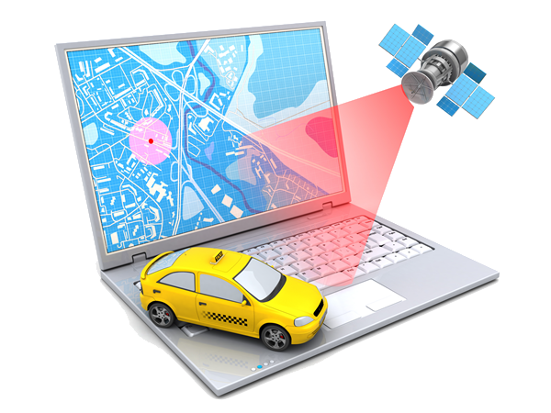
THANK YOU
Q&A
Web App
Mobile App
Database
Testing & Debugging
Payment Gateway
App Launching
Backend
Live Location Tracking

